Slide 1
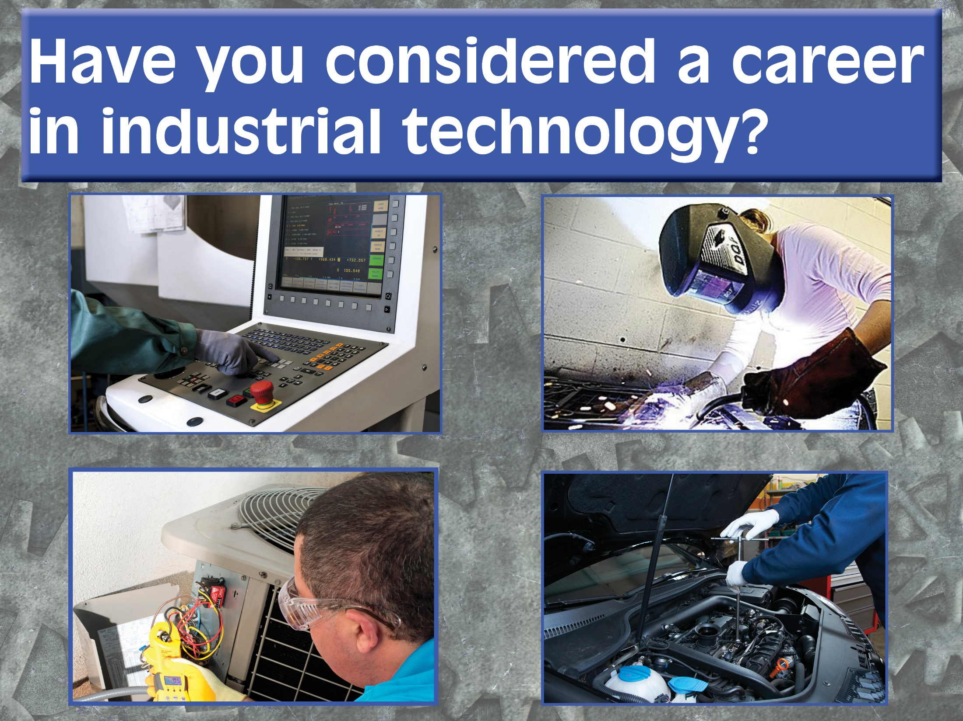

Slide 2

Looking for a new fresh career that will challenge you?
Manufacturing is making a comeback.

Slide 3
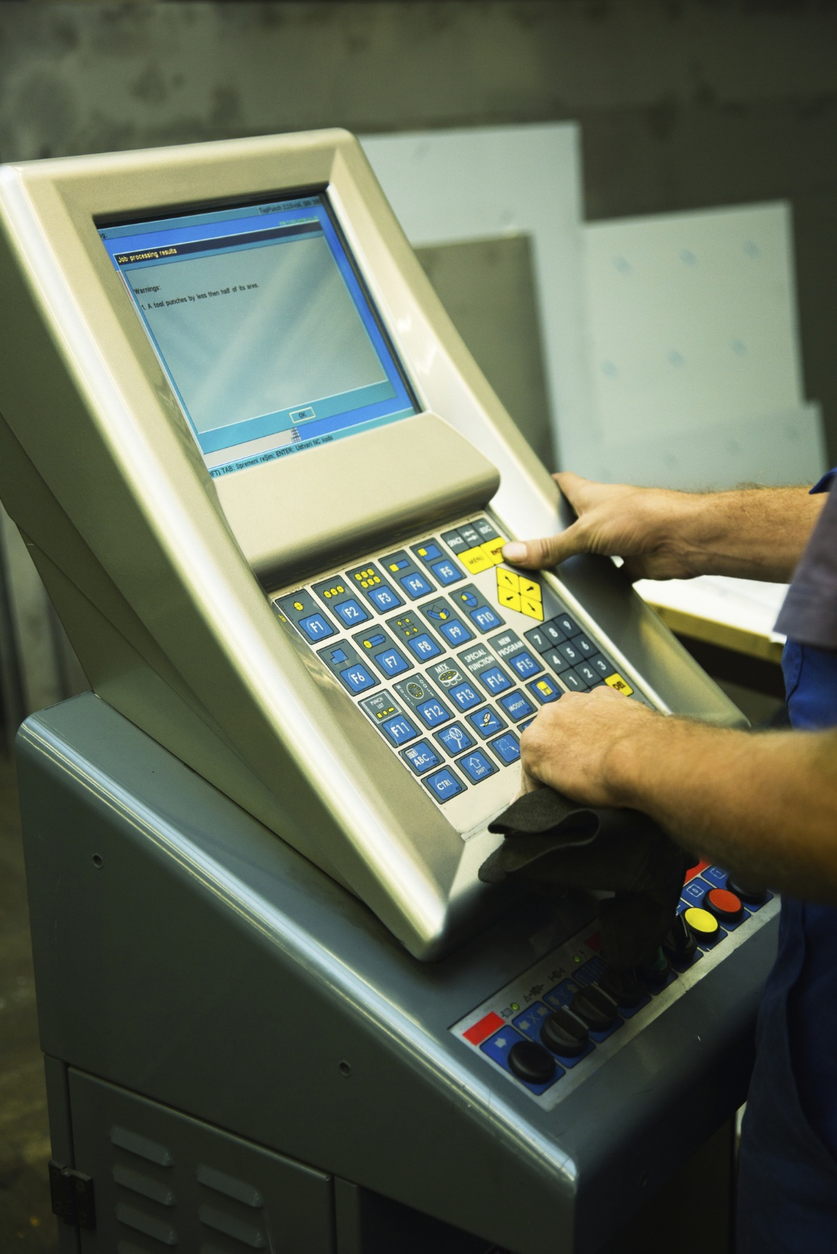
Want to learn a skill that employers are willing to pay for?
Expected job growth is 15% over the next few years.

Slide 4

These jobs are not just for men anymore.

Slide 5

Our industrial technology programs offer hands-on learning.

Slide 6
Degree and certificate programs are available to help you start your career now.
Manufacturing Technology
Welding Specialist
HVACR Technician
CNC Operator
Millwright
Machinist
Maintenance Technician

Slide 7

Median Hourly Wages:
HVACR Mechanics/Installers $26.03
Industrial Machine Installers, Repair, Maintenance Worker $22.53
Plumbers/Pipefitters/ Steamfitters $30.09
Millwrights $22.69
CNC Programmers $20.81
Welders, Cutters, Solderers $17.41
U.S. Department of Labor Statistics, May 2012

Slide 8

Industrial Technology @PSC
Where skills = success

Slide 9
Want to learn more?
Want a tour of the labs?
Contact:
Martin Wolfe, coordinator, industrial technology
(708) 709-7807, mwolfe@prairiestate.edu, office T145
Bill Kuban, coordinator, industrial technology
(708) 709-3783, wkuban@prairiestate.edu, office T145
Danielle Jones, academic advisor, career and technical education, (708) 709-3741, dljone@prairiestate.edu, office 2161

